Slide 1
Engaging Settings
A Narrative Writing Module

Slide 2
Elements of Story Setting, character, plot, and theme
Setting: a story’s place and time
Audiences experience setting through the viewpoint of the story’s characters.
Notes:
Time of Instruction for Introduction / Slides 2-7: 5 minutes

Slide 3
Elements of Setting Place and Time
In real life, we experience places visually through sight and through our other senses—sound, smell, taste, and touch or feel.
Notes:
Instructor’s Notes: Photos, like the ones in this introduction, and videos produced for television and film have the advantage of visual representation to engage the viewer.

Slide 4
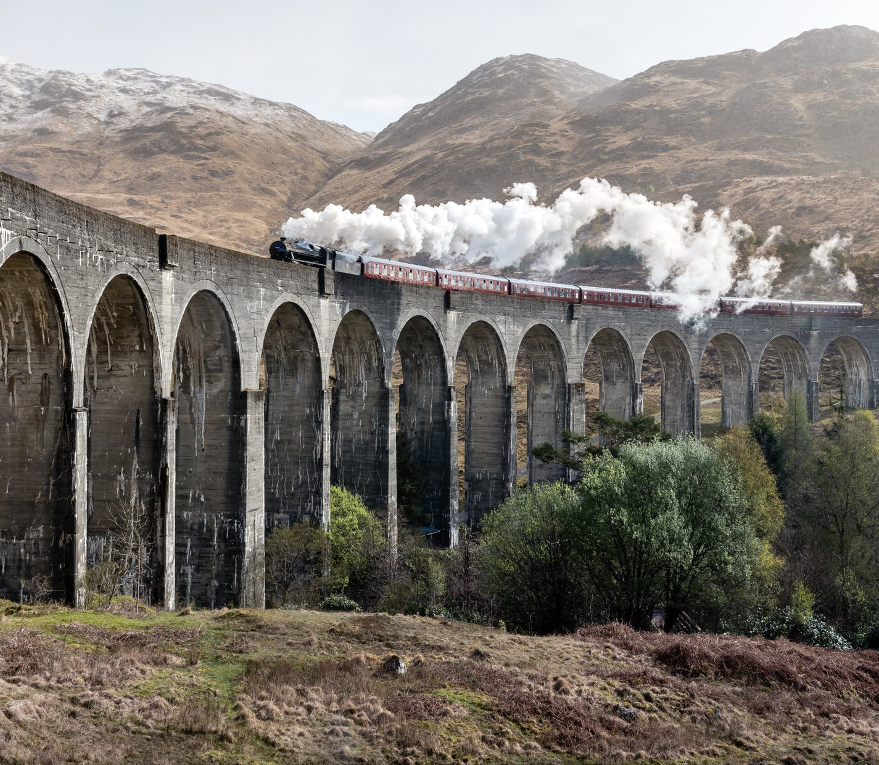
Engaging Settings
Narrative writing relies only on description to create vivid, engaging settings.

Slide 5
Engaging Settings
In English and language arts classes, you’ve learned to identify setting and character as story elements. But how do writers engage readers with these settings?

Slide 6
Goals and Objectives
This module covers narrative writing techniques to clearly and effectively describe settings using sensory details to engage readers. During this unit, you will:

Slide 7
Goals and Objectives
Recognize and interpret how the point of view character influences narrative description
Use active verbs and adjectives to describe sensory details
Produce a logically connected, descriptive narrative paragraph using these techniques

Slide 8
Point of View
To determine the point of view, ask:
Who is the story about?
Who is telling this story?
When are they telling it?
Notes:
Time of Instruction for Point of View - Identify / Slides 8-15: 5 minutes

Slide 9
Point of View
The main character, or POV character, tells us who the story is about. When the main character or actor tells the story directly, the narrative uses first-person voice, with pronouns including I, my, me, we, our, and us.

Slide 10
Point of View
When someone outside of the action tells the story—a narrator—the story uses third-person voice, with pronouns including he, him, she, her, they, or them.

Slide 11
Point of View
The tense tells us when the story is being told. Stories told as they happen use present tense.
Stories told after the action takes places use past tense.

Slide 12
Point of View
I kick the ball across the field.
Sam kicked the ball across the field.
First Person
Present Tense
Third Person
Past Tense

Slide 13
Point of View
J.K. Rowling wrote the Harry Potter series in third person, past tense, but Harry is the main character, the point of view character.

Slide 14
Point of View
How might the story have been different from Ron Weasley’s perspective?
For Ron, Hogwarts might have just been—a school.
Notes:
For Harry, going to Hogwarts was an escape from an abusive home. He loved it—for the first time in his life, a place felt like home. Readers felt that emotion for Harry’s world through his point of view.

Slide 15
Setting Example: A Graveyard
Notes:
Time of Instruction for Sensory Detail- Identify / Slides 15-28: 7 minutes
Instructor’s notes: Let’s look at an example of a setting description and the point of view used to describe it.

Slide 16
Setting Example: A Graveyard
Was the description what you expected for a graveyard?
Notes:
For Bod Owens, the POV character, a graveyard isn’t a scary or sad place—it’s his home. He lives there, and Silas is one of the adults who looks after him.

Slide 17
Setting Example: A Graveyard
Doesn’t use “I” = Third Person
Past Tense
Bod is the POV character.
Silas gave Bod a quest—to find each of the twenty-six letters in the graveyard—and Bod finished it, proudly… Every day Bod would take his paper and crayons into the graveyard…
Notes:
Let’s look specifically at the point of view Gaiman uses. In a novel, the POV character is usually established from the beginning of the book. Bod Owens is the main character in The Graveyard Book.

Slide 18
Setting Example: A Graveyard
A sunny day: bumblebees explored the wildflowers that grew in the corner of the graveyard, dangling from the gorse and the bluebells, droning their deep lazy buzz while Bod lay in the spring sunlight watching a bronze-colored beetle wandering across the stone of G. Reeder…
Notes:
Now look at how Gaiman describes the scene. First, Bod is relaxed in this place, watching what’s happening around him. The description that follows is positive because we see it from Bod’s perspective.

Slide 19
Setting Example: A Graveyard
Active Verbs
A sunny day: bumblebees explored the wildflowers that grew in the corner of the graveyard, dangling from the gorse and the bluebells, droning their deep lazy buzz while Bod lay in the spring sunlight watching a bronze-colored beetle wandering across the stone of G. Reeder…
Notes:
Notice the words in yellow. These are all active verbs. Gaiman isn’t telling us what it looks like—things are happening, and the reader is engaged by visualizing the action in the scene.

Slide 20
Setting Example: A Graveyard
Adjectives
A sunny day: bumblebees explored the wildflowers that grew in the corner of the graveyard, dangling from the gorse and the bluebells, droning their deep lazy buzz while Bod lay in the spring sunlight watching a bronze-colored beetle wandering across the stone of G. Reeder…
Notes:
Notice the words in green. These are adjectives that help to paint or fill in some of the details of that scene.

Slide 21
Setting Example: A Graveyard
Sensory details using nouns
A sunny day: bumblebees explored the wildflowers that grew in the corner of the graveyard, dangling from the gorse and the bluebells, droning their deep lazy buzz while Bod lay in the spring sunlight watching a bronze-colored beetle wandering across the stone of G. Reeder…
Notes:
Notice the words in blue. These nouns provide us with sensory details—visually we can imagine the wildflowers, the bees, the sunlight, the beetle, and the stone. We have a sound included—the buzz of the bees—and the two uses of sun imply a warm feeling.

Slide 22
Engaging Settings
Authors show characters interacting with the setting by using:
Active verbs
Adjectives
Nouns that convey sensory details

Slide 23
Setting Example 2: Orlando at Night

Slide 24
Setting Example 2: Orlando at Night
Quentin is the POV character.
Uses “I” and “we” = First Person
Past Tense
We jogged across I-Drive and then started bushwhacking through a thicket of tall shrubs and oak trees. I started to worry about poison ivy,
Notes:
(Begin Guided Practice) Let’s start with the point of view Green uses. Quentin is the main character in Paper Towns. Who can tell us the voice in this point of view? What about the tense?

Slide 25
Setting Example: Orlando at Night
Active Verbs
We jogged across I-Drive and then started bushwhacking through a thicket of tall shrubs and oak trees. I started to worry about poison ivy, but ninjas don’t worry about poison ivy, so I led the trail, my arms in front of me, pushing aside briars and brush as we walked toward the moat. …
We jogged across I-Drive and then started bushwhacking through a thicket of tall shrubs and oak trees. I started to worry about poison ivy, but ninjas don’t worry about poison ivy, so I led the trail, my arms in front of me, pushing aside briars and brush as we walked toward the moat. …
Notes:
Remember our descriptions need active verbs, adjectives, and sensory details. Who can find some active verbs in this paragraph?

Slide 26
Setting Example: Orlando at Night
Adjectives
(and more Active Verbs)
We made it across and then knelt down in the knee-high grass beside the parkway….
And I didn’t think about alligators or the disgusting layer of brackish algae. I just got a running start and jumped as far as I could. I landed in waist-deep water and then high-stepped across.
We made it across and then knelt down in the knee-high grass beside the parkway….
And I didn’t think about alligators or the disgusting layer of brackish algae. I just got a running start and jumped as far as I could. I landed in waist-deep water and then high-stepped across.
We made it across and then knelt down in the knee-high grass beside the parkway….
And I didn’t think about alligators or the disgusting layer of brackish algae. I just got a running start and jumped as far as I could. I landed in waist-deep water and then high-stepped across.
Notes:
Who can find some adjectives in this paragraph?
Notice, also, more of those active verbs--

Slide 27
Setting Example: Orlando at Night
Sensory Details
The water smelled rank and felt slimy on my skin, but at least I wasn’t wet above my waist. …
We ran through a small thicket of trees, hugging tight against these huge opaque tanks that might have stored animals, and then we came to an asphalt path and I could see the big amphitheater where Shamu splashed me when I was a kid. The little speakers lining the walkway were playing soft Muzak.
The water smelled rank and felt slimy on my skin, but at least I wasn’t wet above my waist. …
We ran through a small thicket of trees, hugging tight against these huge opaque tanks that might have stored animals, and then we came to an asphalt path and I could see the big amphitheater where Shamu splashed me when I was a kid. The little speakers lining the walkway were playing soft Muzak.
Notes:
We’ve had several visual or sight details at this point. Let’s identify more sensory details, where the active verbs and adjectives work with the nouns to create descriptive sentences.
We have the smell and feel of the water, the sight of the trees, the tanks, and the amphitheater and Shamu, and the sound of Muzak. (4 of the 5 senses in only 3 sentences.) *If a student asks, the last sentence does use the passive were playing but makes up for it with an active verb with the speakers lining the walkway.

Slide 28
Engaging Settings
We’ve identified the techniques of using point of view, active verbs, adjectives, and sensory details to describe settings. Now we need to apply them in our own writing.

Slide 29
1. Establish the Point of View (W W W W H)
Who: POV character
What: Character interacts with the setting
When: Present or Past Tense
Where: Place and Time
How: First-person POV or third-person narrator
Notes:
Time of Instruction for Point of View - Establish / Slides 29-32: 5 minutes
Instructor’s Notes: We can use WWW questions to identify and establish a point of view. For this practice, these answers will be given.

Slide 30
1. Establish the Point of View (W W W W H)
Who: Sam, a teen boy with a younger sister, Jenny
What: Sam wants to choose a gift for Jenny
When: Present Tense
Where: Jenny’s bedroom, daytime
How: First person
Notes:
Today, we’ll also be using visual prompts to practice the techniques.

Slide 31
Notes:
We’ll use this photo as Jenny’s room. (A photograph of a bedroom with a bookcase on the left, windows behind the bed, a computer and headphones on the bed, shoes on the floor, and a nightstand on the right with an apple, a lamp, and more books.)

Slide 32
1. Establish the Point of View
Sam is interacting with the room and trying to decide on a gift.
Uses “I” = First Person
Present Tense
I walk into my sister’s room and sigh. Jenny always knows exactly what I’ll like, but she’s a mystery to me.
Notes:
I need to compose a sentence in the chosen point of view that places Sam in the room in an active way.

Slide 33
2. Describe a Sensory Detail
Choose an action related to an object.
Choose an adjective to describe the object that can be experienced through the senses.
Put them together in the established POV.
Notes:
Time of Instruction for Sensory Detail- Compose / Slides 33-43: 14 minutes
Now we need to compose a descriptive sentence in the chosen point of view. We need to choose an action, and adjective, and a sensory detail.

Slide 34
Notes:
I notice the colorful items here—Jenny seems to have a lot of books. Let’s have Sam interact with the books.

Slide 35
2. Describe a Sensory Detail
Action: Sam will interact with the books.
Look, pick up, flip pages, drop?
Adjective and sensory detail: Sam can see them, and they have jackets in different colors.
Pink, green, blue
Notes:
We need to choose an action, and adjective, and a sensory detail.

Slide 36
2. Describe a Sensory Detail
I look at the books on the shelf. The covers are bright pink, green, and blue.
I look at the books on the shelf. The covers are bright pink, green, and blue.
Noun
Passive verb
The jackets cover
Active verb
Notes:
Next I’ll compose the sentence, staying in Sam’s 1st person POV. I have an active verb. It’s a visual detail, and I have multiple adjectives. This is okay, but the descriptive sentence has a passive verb, are. Cover is a noun, but it can also be an active verb.
Those covers on the books can also be called jackets, and they are covering the titles. I’m going to use that as an active verb here.

Slide 37
2. Describe a Sensory Detail
Bright pink, green, and blue paper jackets cover all the books on her shelf, hiding the titles on the spines.
Bright pink, green, and blue paper jackets cover all the books on her shelf, hiding the titles on the spines. To know what she already has, I’ll have to open every one.
Notes:
Here is the new sentence.
I have my active verb—cover, my adjectives, bright pink, green, and blue, and Sam is seeing this. It stays in Sam’s POV.

Slide 38
3. Describe Two More Sensory Details
Choose two more different sensory details to describe how Sam interacts with the room. Again we need at least one active verb and at least one adjective per sentence.
Notes:
We have a sight detail now, so next we’ll add two different sensory details.

Slide 39
Notes:
I notice the apples—those have taste. I see the headphones and the computer—those make sounds. The blanket and carpet probably feel soft. And the makeup and cosmetics may have a smell.

Slide 40
3. Describe Two More Sensory Details
Action: Sam will interact with the cosmetics and the computer.
Adjective and sensory detail: Sam can smell the floral perfume and hear the old computer.
Notes:
We need to choose an action, and adjective, and the sensory details.

Slide 41
3. Describe Two More Sensory Details
I cross the room to check her perfume supply, but I sneeze at the heavy floral smell in the air before I even pick up the full glass bottle.
I cross the room to check her perfume supply, but I sneeze at the heavy floral smell in the air before I even pick up the full glass bottle.
Notes:
Next I’ll compose the sentences. Sam will cross the room to check the perfume.
I check back to make sure I active verbs, adjectives, and a sense—here it’s smell.

Slide 42
3. Describe Two More Sensory Details
I plop down on the unmade bed and wake up her computer. The old, hand-me-down laptop whirs to life, and I don’t recognize the band in the background photo or a single one of the songs in her recent downloads.
I plop down on the unmade bed and wake up her computer. The old, hand-me-down laptop whirs to life, and I don’t recognize the band in the background photo or a single one of the songs in her recent downloads.
Notes:
Next Sam will wake up the computer to see what music she likes.
I check back for active verbs, adjectives, and a sense—here it’s the sound of the computer whirring.

Slide 43
A Description of Setting
I walk into my sister’s room and sigh. Jenny always knows exactly what I’ll like, but she’s a mystery to me. Bright pink, green, and blue paper jackets cover all the books on her shelf, hiding the titles on the spines. To know what she already has, I’ll have to open every one. I cross the room to check her perfume supply, but I sneeze at the heavy floral smell in the air before I even pick up the full glass bottle. I plop down on the unmade bed and wake up her computer. The old, hand-me-down laptop whirs to life, and I don’t recognize the band in the background photo or a single one of the songs in her recent downloads.
Notes:
When we put the full paragraph together, it’s logically connected—Sam is trying to choose a gift. He’s in Jenny’s room interacting with her things. This full paragraph is 7 sentences long and 125 words.

Slide 44
Notes:
(Student Practice – Distribute note cards.) Next, you’re going to practice these techniques. For this practice, we’re using a given point of view and the same visual prompt for the room. We’re still with Sam, using third person, past tense, and we’re still in Jenny’s room. The difference this time is Sam’s reason for entering the room.

Slide 45
Practice
Write a brief introduction to establish the point of view and two descriptive sentences using an active verb, an adjective, and two different sensory details in that POV.
1. Establish the POV Character
Who: Sam
What: Something is missing, and Sam thinks Jenny took it.
When: Past Tense (optional)
Where: Jenny’s Room
How: Third Person (optional)
2. Describe 2 Sensory Details
Choose an action related to an object.
Choose an adjective to describe the object that can be experienced through the senses.
Put them together in the established POV.
Notes:
Independent Practice/ Slides 45-46: 10 minutes
(Distribute cards if in person) On the cards, write a brief introduction to establish the point of view and one descriptive sentence using an active verb, an adjective, and a sensory detail. Please check if it’s okay to anonymously share your sentence with the class. (Use private instant messaging or email if remote) Write a brief introduction to establish the point of view and two descriptive sentences using an active verb, an adjective, and a sensory detail. Please indicate if it’s okay to anonymously share your sentence with the class.

Slide 46
Practice
1. Establish the POV Character
Who: Sam
What: Sam’s wallet is missing, and he thinks Jenny took it.
When: Past Tense
Where: Jenny’s Room
How: Third Person
2. Describe a Sensory Detail
Choose an action related to an object.
Choose an adjective to describe the object that can be experienced through the senses.
Put them together in the established POV.
Notes:
(Point out strong examples individually and read aloud strong examples, pointing out the technique.)

Slide 47
Assessment Paragraph
Engaging Settings
Notes:
(Distribute Assignment and Rubric and Review With Class) Time for Assessment: 10-15 minutes

Slide 48
Optional Point of View Characters
A teen girl, Jen, walking home after school with chores to do.
A teen boy, Mark, looking for his lost dog.
Notes:
You’ll have two optional point of view prompts and two optional visual prompts—you can also use your own, as long as you adhere to the assignment.

Slide 50
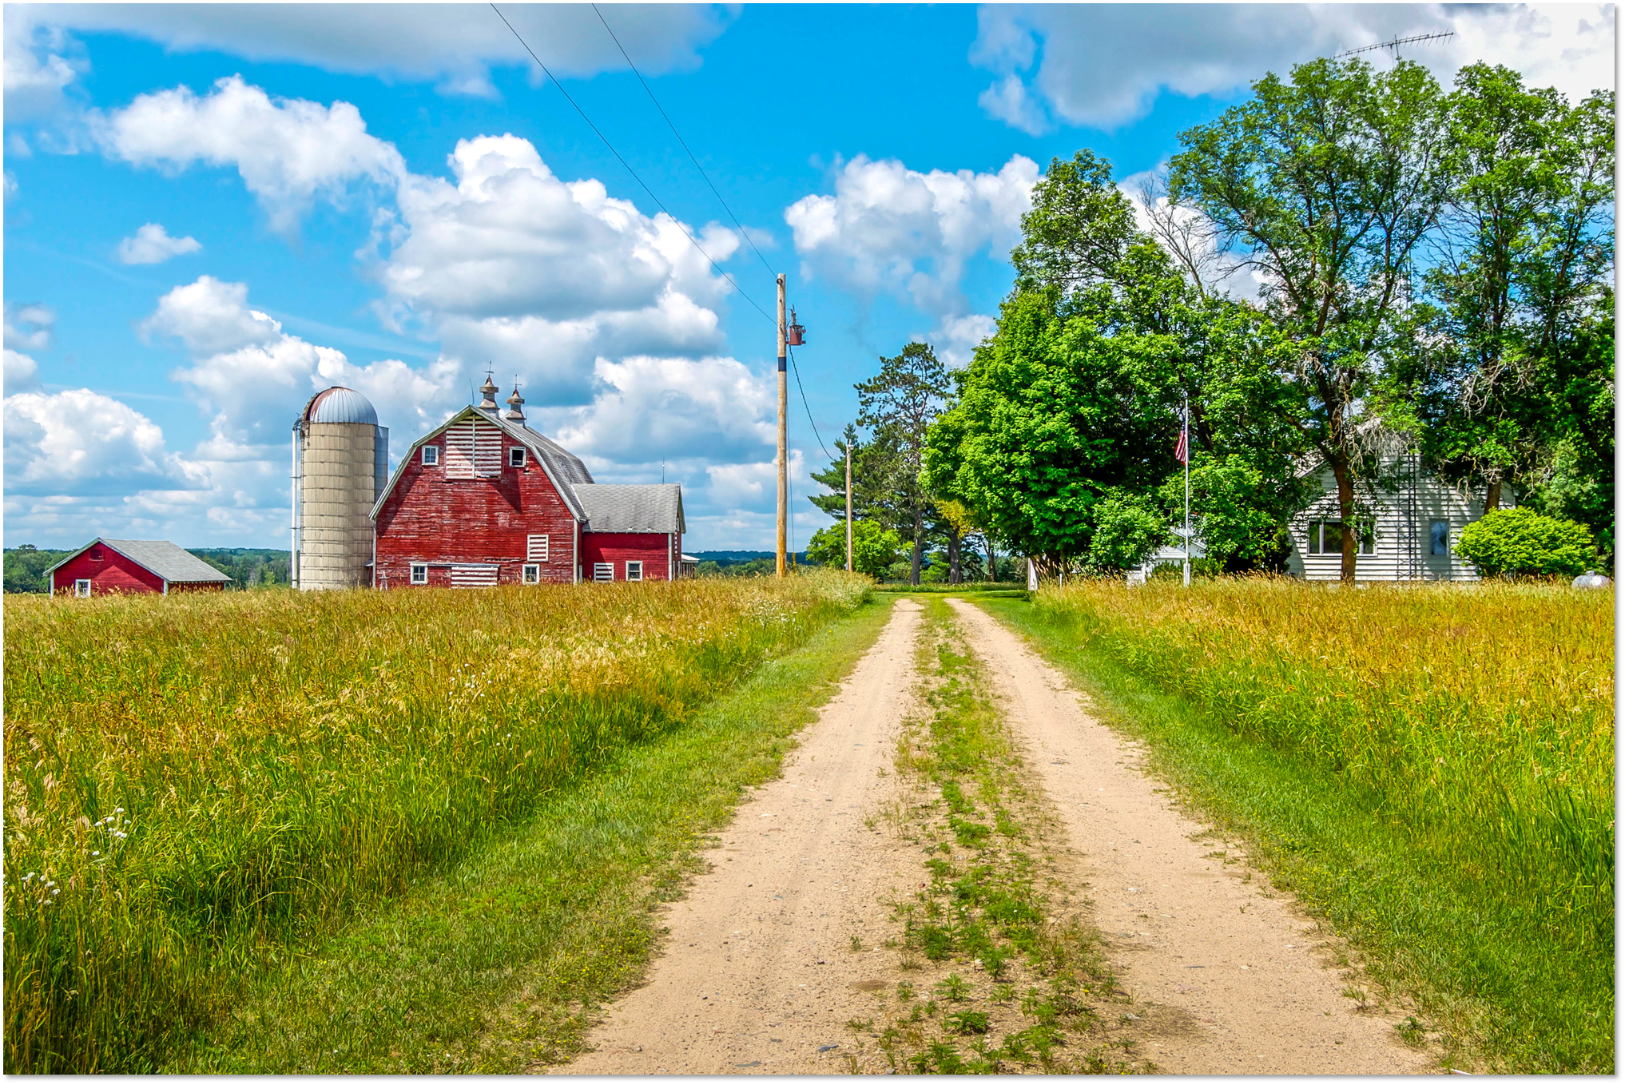

Slide 51
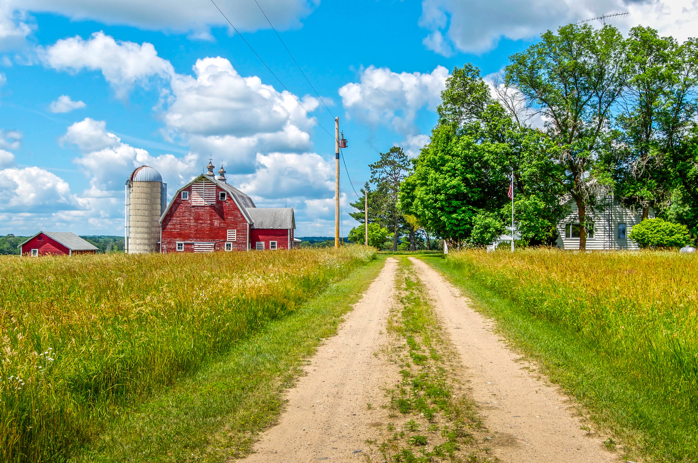
Mark, a teen boy looking for his lost dog.
Jen, a teen girl going to do chores after school.

