Slide 1
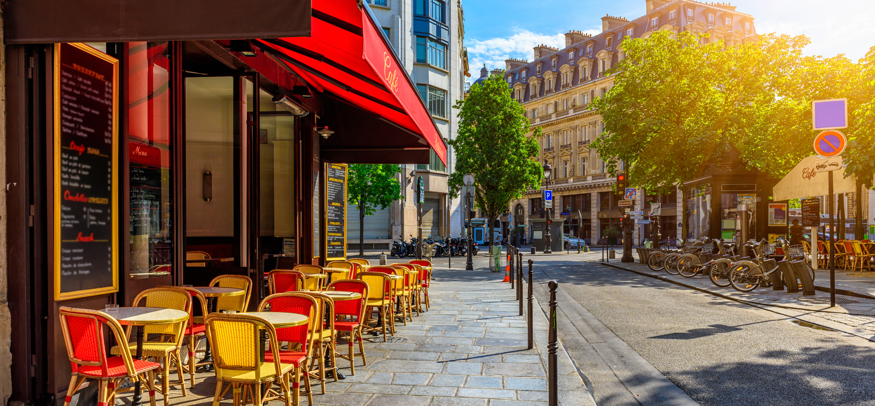
Paris in the Spring

Slide 2
Summer at the Beach

Slide 3
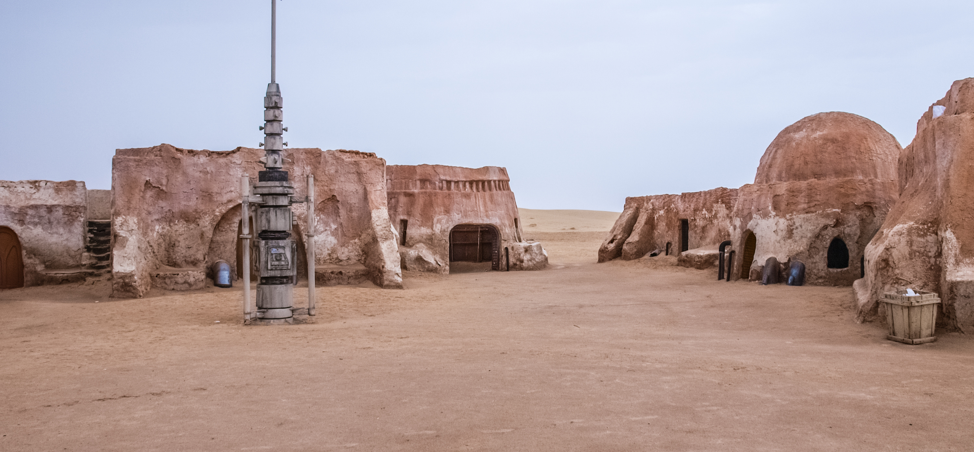
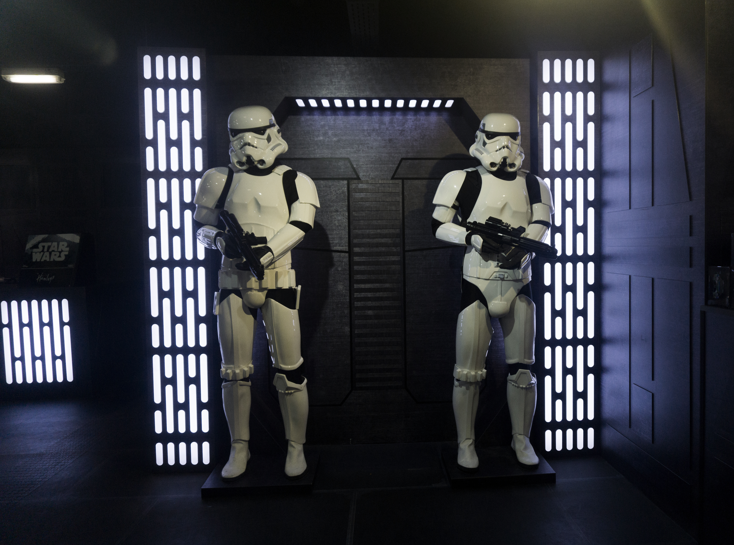
A long time ago in a galaxy far, far away…

